Slide 1
77 REVERE STREET
ROOF DECK

Slide 2
SCOPE OF WORK:
DEMO EXISTING DECK. REMOVE THE FLAT RUBBER ROOF AND REPLACE WITH A NEW FLAT RUBBER ROOF, INSTALL NEW FRAME, TREX DECKING, REINSTALL BLACK METAL HANDRAILS, HEADHOUSE FINISHED IN VINYL SIDING AND PVC TRIM
Note that new deck will have a lower finished height than the existing
deck and will no longer have a step up from the headhouse.
New storage shed will be reframed to same size as existing and
adjusting for the new finished deck height.
- Storage shed will be have plywood sheathing on the walls and roof
and wrapped with Tyvek house wrap
- CertainTeed vinyl siding will be installed to complete the exterior walls of the shed and HeadHouse, along with PVC trim.
New exterior MMI (60 in x 80 in) fiberglass double door will be
supplied and installed on shed.
Trex Enhance composite decking will be supplied and installed
throughout deck area.
Existing wrought iron metal railings will be reused in their existing
location.
- Existing sections of railings will be re-welded back together and spot
painted as needed.
- Approximately 25 feet of new wrought iron, 42 inch tall metal railings
will be manufactured, painted and installed to match existing railings.
- Railings will be bolted to the top of the deck on blocks.
Existing active chimneys around the deck may need to be raised to
meet the building code of being 7 feet above the deck line.
- Flues inside of chimney will have to be raised and chimney cap reattached
- Chimney will be built up with new bricks (closest match to existing
bricks as possible)

Slide 3
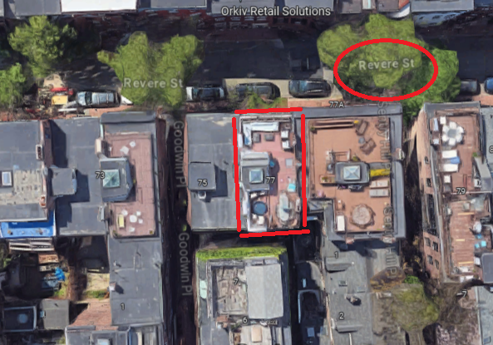

Slide 4
EXISTING PHOTOS:
PICTURE 1. THESE BEAUTIFUL RAILINGS WILL BE SET ASIDE AND REINSTALLED.
PICTURE 2. THIS FENCE WILL BE REPLACED WITH NEW RAILINGS, AN EXACT REPLICA OF THE EXISTING RAILING IN PIC 1. ALSO THE STEP UP AREA WILL NOT BE PART OF THE NEW DECK, IT WILL ALL BE LEVEL.

Slide 5
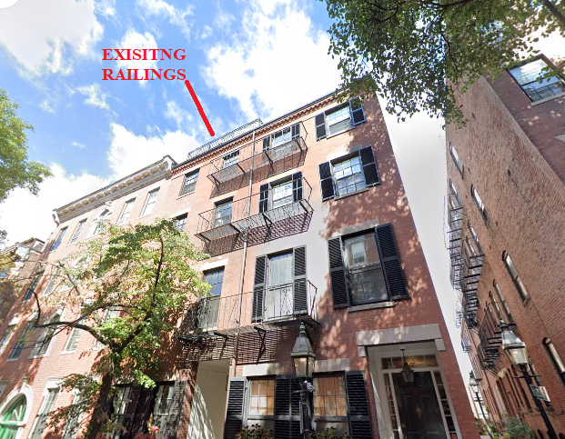
THE EXISTING RAILINGS ARE VISIBLE FROM
STREET VIEW. THE NEW PROPOSED DECK
WILL SET BACK THE RAILINGS 2’6” FROM
THE ROOF LINE AND WILL NO LONGER
FROM BELOW.

Slide 6
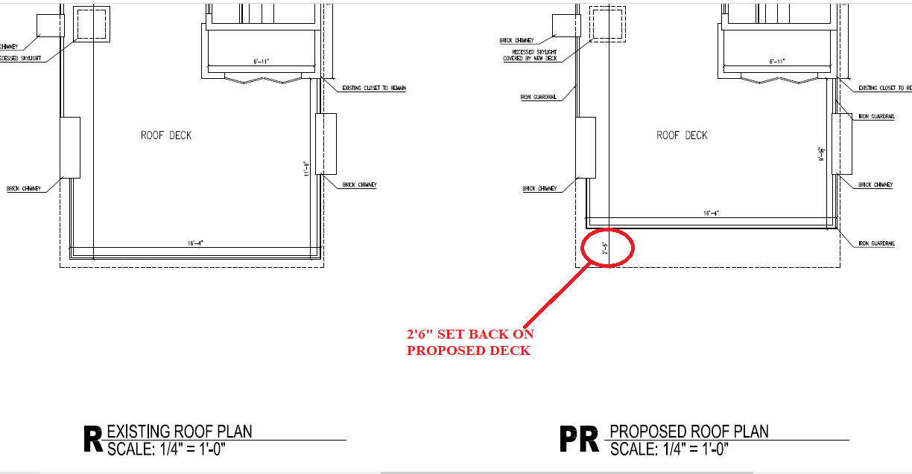
THE NEW DECK RAILS WILL BE SET BACK 2’6” FROM THE ROOF LINE

Slide 7
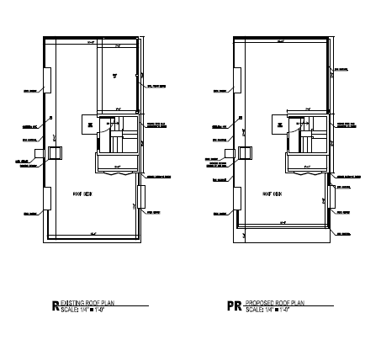
1) STEP UP AREA AT THE REAR OF THE DECK TO BE REMOVED
2) HEADHOUSE IS LOCATED IN THE CENTER OF THE DECK AND NOT VISIBLE FROM STREET VIEW
3) THE SETBACK FOR THE RAILINGS WILL MEAN THE ARE NO LONGER GOING TO BE VISIBLE FROM STREET VIEW

